Slide 1
Introduction
Said Nabi

Slide 2
Instructor
Email: sajid.ali@giki.edu.pk
Faculty of Computer Science and Engineering
Office: S-23, New Academic Block
Office Hours:
You may visit me anytime except during scheduled classes.

Slide 3
Course TA
Yet to be announced
Never hesitate to contact TA or me whenever you have some problem

Slide 4
Some Rules
There is only one rule that will make the rest of the rules
  Raise your hand before asking any question and then WAIT for the permission
  Never ever miss a class
  Never ever “sleep” in the class
  Never even think to use mobile phones in the class
  Always communicate in the official communication language

Slide 5
Books
  C++20 For Programmers: An Objects-Natural Approach

Slide 6
Reference Books
  Tony Gaddis, Starting Out with C++ from Control Structures to Objects (8th Edition) Publisher: Pearson; 8 edition
  D. S. Malik "C++ Programming: From Problem Analysis to Program Design" 8th Edition
  Walter Savitch "Problem Solving with C++" 10th Edition

Slide 7
Dishonesty, Plagiarism in Quizzes, Assignments
All individuals involved in any kind of cheating in any exam, quiz, assignment or project will get -60% score.

Slide 8
Attendance
Students are required to attend 100% classes of courses registered and can not abstain from even a single class.
For circumstances beyond their control, students must apply for leave on prescribed Leave Application form.

Slide 9
Tentative Evaluation Breakdown
Assignments (4 – 5) | 10
Quizzes (5 – 7) | 10
Term Project (1) | 10
Midterm (1) | 30
Final (1) | 40
Total | 100

Slide 10
Course Execution
2 lectures of one hour every week
1 lab of three hours every week, CS112L
Mind it: Lecture scheduling is to be done by the Dir. (A&E). Please avoid visiting me for any clashes

Slide 11
Notes
Course contents and their order may be slightly modified during the course execution.
No make up for missed quizzes or assignments/homeworks
Deadline for assignments and projects are always final.
Quizzes may be announced or un-announced
Serious action will be taken for any kind of cheating
Visual Studio.Net (version yet to decide) will be used for GUI and console programming
All assignments and project will be on individual bases
Mid and Final exam of lab will be conducted on the IDE

Slide 12
Course Outline
Week 1 | User defined data types, Structures, Unions and Enumerations
Week 2 | Recursion, Preprocessing in C++
Week 3 | Bit Manipulation, Strings, Pointers
Week 4 | Reference and Dynamic memory allocation
Week 5 | Function Pointers, ADTs and C++ Classes-I
Week 6 | C++ Classes-II Constructor, Destructor, Copy Constructor
Week 7 | Inheritance, Virtual Functions and Polymorphism
Week 8 | Operator Overloading, Function and class templates
Week 9 | Exception Handling
Week 10 | I/O Streams and File Handling
Week 11 | Graphics
Week 12 | GUI Programming
Week 13 | Introduction to Standard Template Library
Week 14 | GUI

Slide 13
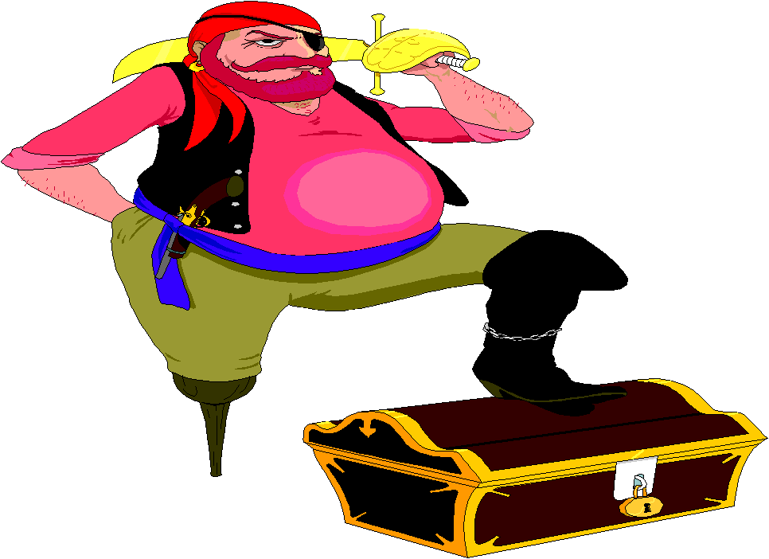
Motivation
Only 1 programming course out of approx. 40 courses
Core of core of computer science
Excellent Programming = Excellent chances of good job
Remember practice makes a person “perfect”.
  Same goes for programming.

Slide 14
Course objective
In simple words, you will learn how to write object-oriented programs
Object Oriented Programming-Spring 23

Slide 15
What is Object Oriented Programming?
Procedural programs are organized as a procedures or functions that perform operations on the data; OOP provides another way to organize your programs
Object oriented programs are organized as groups of objects that have certain attributes and can take certain actions.
  When the program executes these objects
  interact with each other.
Object Oriented Programming-Spring 23

Slide 16


Some Examples of Objects
Car
Attributes:
  balance
Behavior
  Deposit
  Withdraw
  Check balance
Attributes:
  Gas in tank
  Mileage
Behavior
  Accelerate
  Brake
  Load fuel
  Check fuel
Bank Account
Object Oriented Programming-Spring 23

Slide 17


Objects Interact with each other
Get Loan
Bank
Customer
Bank Account
Deduct Zakat
Deposit
Withdraw
Object Oriented Programming-Spring 23

Slide 18
Why do we need
Object Oriented Programming?
Due to the limitations of procedural programming (even after structuring into functions and files)
No matter how well structured the program is, as the size of the program increases it becomes excessively complex
Object Oriented Programming-Spring 23

Slide 19
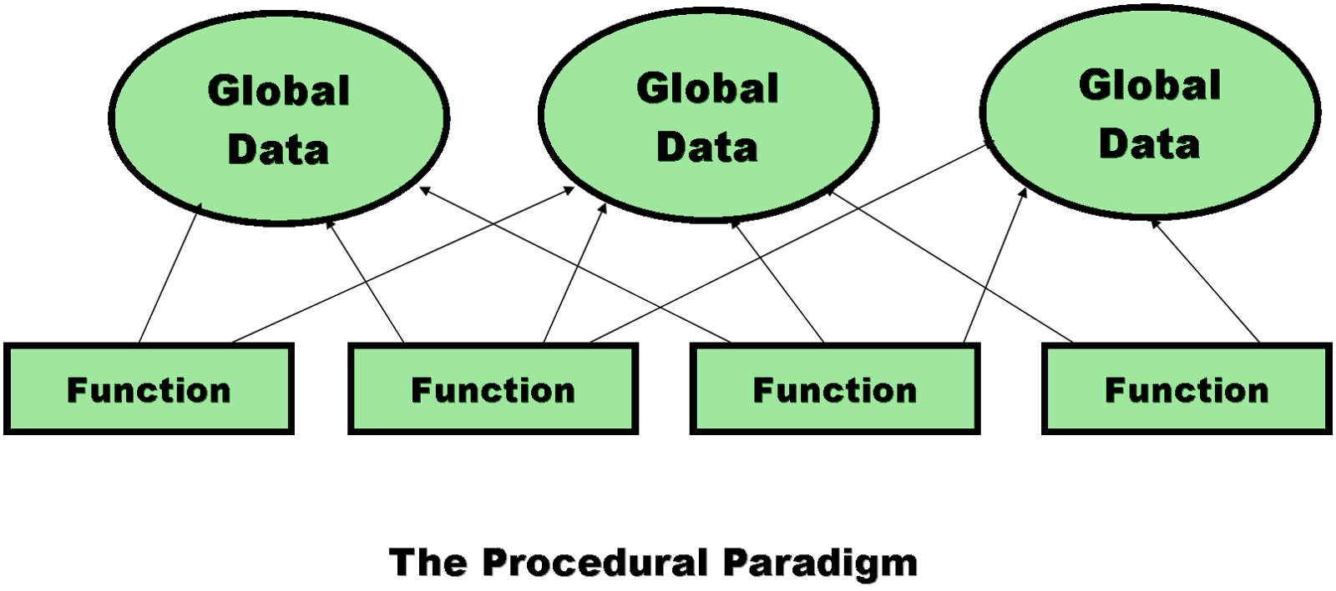
Limitations of procedural programming
1. Unrestricted Access
  Global data can be accessed by any function in the program
Program structure
Difficult to conceptualize
Difficult to modify
Object Oriented Programming-Spring 23

Slide 20
Limitations of procedural programming
2. Poor Real-World Modeling
  Procedural programming arranges data and functions separately.
  In the real world we deal with objects such as people and cars. Such objects aren’t like data and they aren’t like functions
  Complex real-world objects have both attributes and behavior
OOP Programs
Easy to conceptualize
Easy to modify
Object Oriented Programming-Spring 23

